Slide 1
本征像论文汇报（五）
汇报人：方阳

Slide 2
Content
1. Deep Retinex Decomposition for Low-Light Enhancement
（BMVC2018）

Slide 3
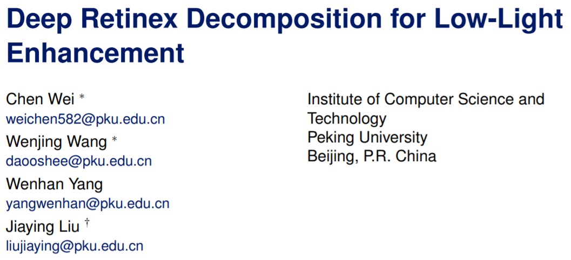

Slide 4
Contributions
We build a large scale dataset with paired low/normal-light images captured in real scenes. As far as we know, it is the first attempt in the low-light enhancement field.
We construct a deep-learning image decomposition based on Retinex model. The decomposition network is end-to-end trained with the successive low-light enhancement network, thus the framework is by nature good at light condition adjustment.
We propose a structure-aware total variation constraint for deep image decomposition. By mitigating the effect of total variation at the places where gradients are strong, the constraint successfully smooths the illumination map and retains the main structures.

Slide 5
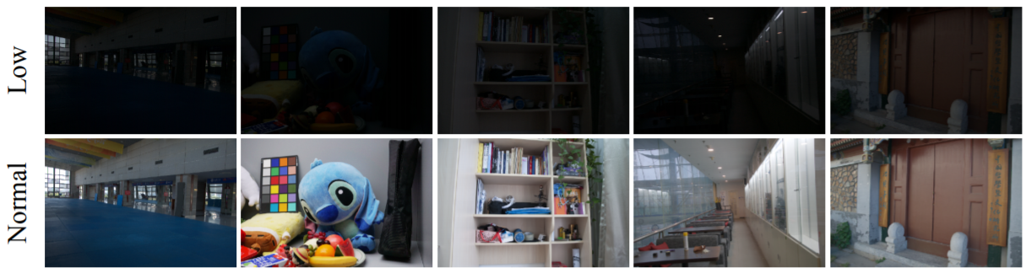
LOL dataset
500 image pairs: 485 pairs for training and another 15 ones for evaluation.

Slide 6
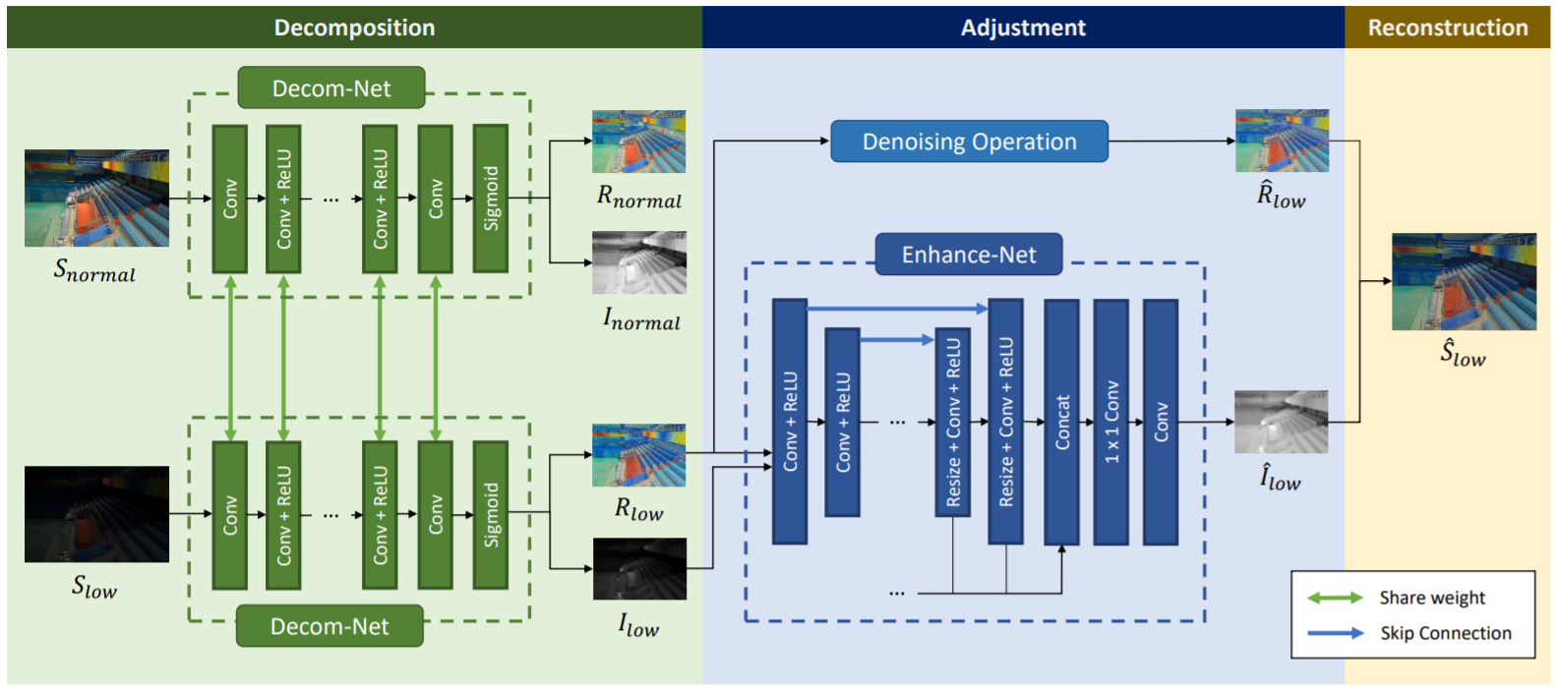
Model Architecture

Slide 7
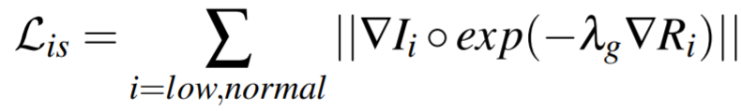
Structure-aware total variation constraint
directly using TV(Total variation) as loss function fails at regions where the image has strong structures or where lightness changes drastically. It is due to the uniform reduction for gradient of illumination map regardless of whether the region is of textual details or strong boundaries. In other words, TV loss is structure-blindness.
$L_{is}$ loosens the constraint for smoothness where the gradient of reflectance is steep, in other
words, where image structures locate and where the illumination should be discontinuous

Slide 8
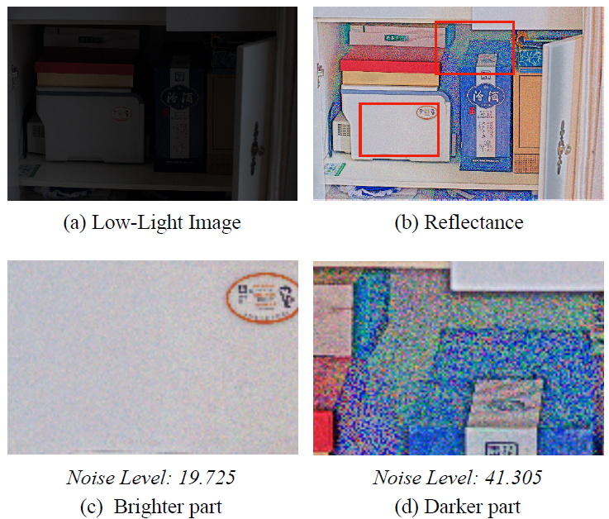
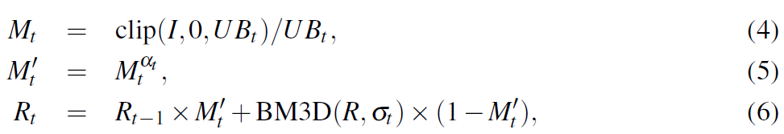
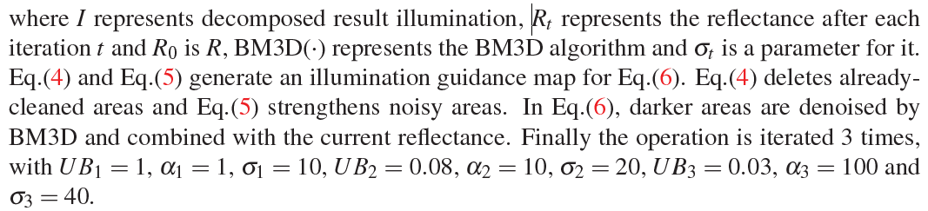
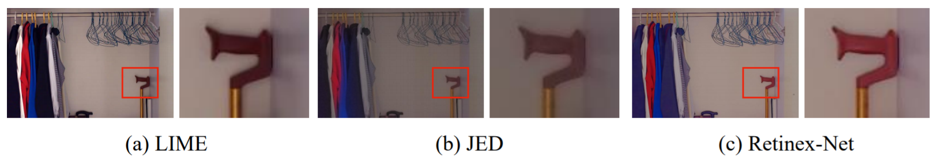
Denoising Operation
Notes:
为了防止亮处过平滑和暗处噪声，采用了一种基于光照的去噪策略。

Slide 9
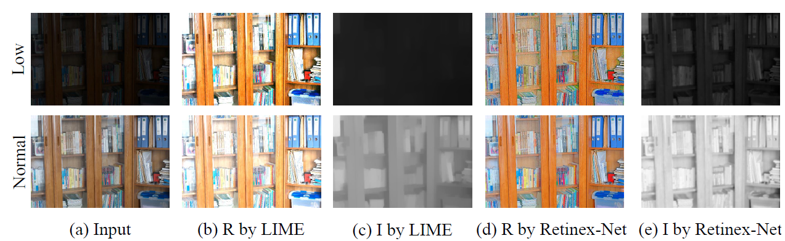
Experiment
Trained on 485 real-case image pairs as well as 1000 synthetic ones
Tested on LOL, LIME, MEF, DICM.

Slide 10
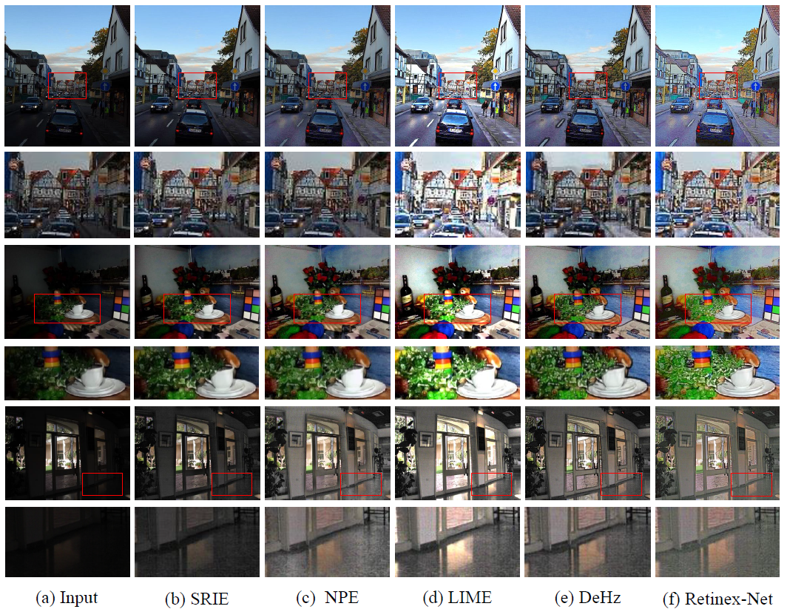
LIME, MEF, DICM.

